Slide 1

Zowe 4Q 2022 PI Planning
ZAC Update
Bruce Armstrong – Michael DuBois – Peter Fandel - Rose Sakach

Slide 2

Topics
Zowe By the Numbers
The Q3 Report Card
Zowe Market/Social News
How are we doing with Zowe V2 Conformance
Quick Zowe (Logistical) Roadmap Status
ZAC Priorities
Notes:
Rose Updated this, what do you think?

Slide 3
Zowe Open Source Community Metrics
Another Quarter Of Growth!
Through Oct 21, 2022
160,667
71,283
6247
CLI Downloads
Explorer Downloads
Server-Side Downloads
+ 12% (143,566) since July 25, 2022
+ 13% (62,934) since July 25
+ 7% (5,841) since July 25
Visitors at zowe.org
598
77 / 42
19,100 Total
15,980 thru July 25, 2022
18,155 New
14,952 thru July 25, 2022
GitHub Contributors
Conformant Zowe Products
+ 6% (566) since July 25
34 V2 July 25
https://www.metrics.zowe.org
https://www.metrics.zowe.org/analytics
Notes:
What’s new and interesting about the metrics?
Q-over-Q: Last quarter vs. this quarter
CLI: 11% / 12%
Explorer: 12% / 13%
Server: 8% / 7%
Github contributors: 8% / 6%
V2 conformance: 34 / 42

Slide 4
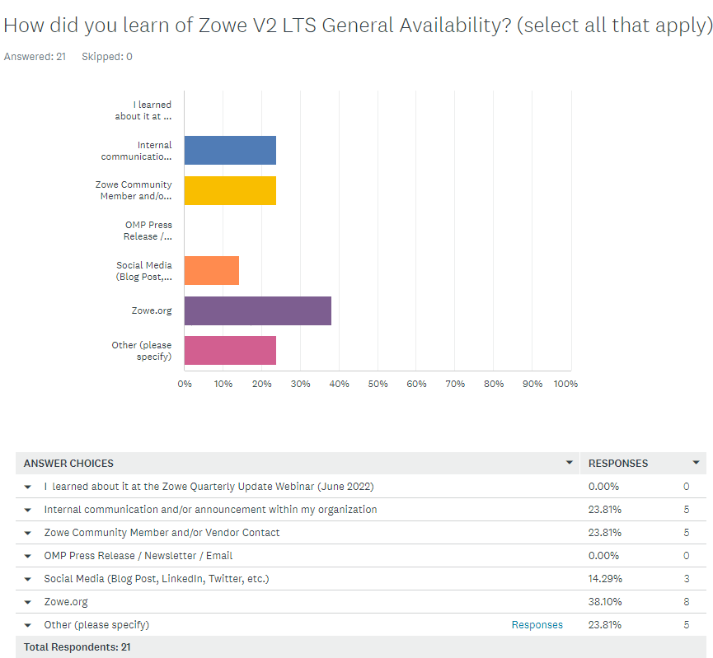
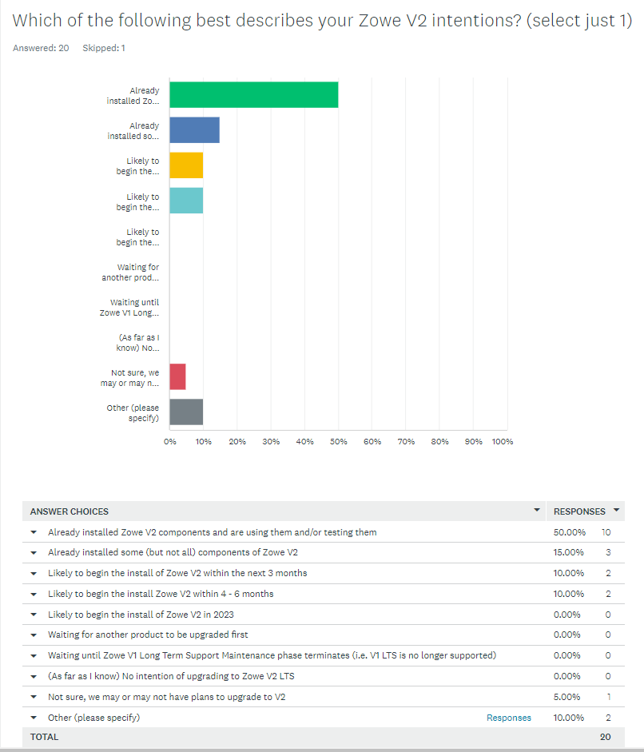
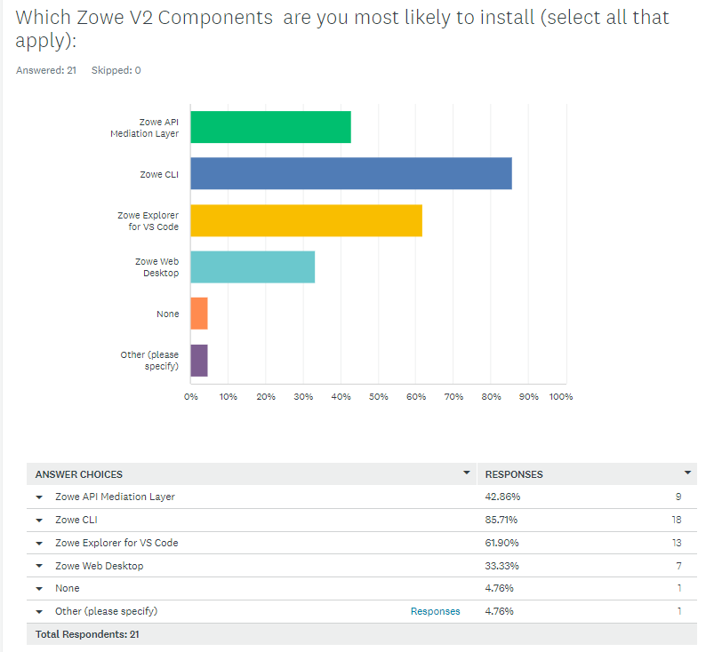
Zowe Open Source Community Feedback
Question-of-the-month: September
Zowe V2 Feedback
Notes:
Observations (General): we are receiving feedback! Low, but we’re hoping to grow!
Zowe.org / indications we have a viable platform for communication? Maybe?
Visitors have embraced v2 (already installed) / Zowe CLI driving V2? Clues to how we drive V2 adoption?
Q1: Other (5)
IBM (1)
Zowe Developer (2)
Zxplore (1)
Virtual Training (1)
Q2: Other (2)
Just learned Zowe available for macOS.
User, not administrator
Q3: Other (1)
Zowe NodeJS SDK, Zowe Python SDK

Slide 5
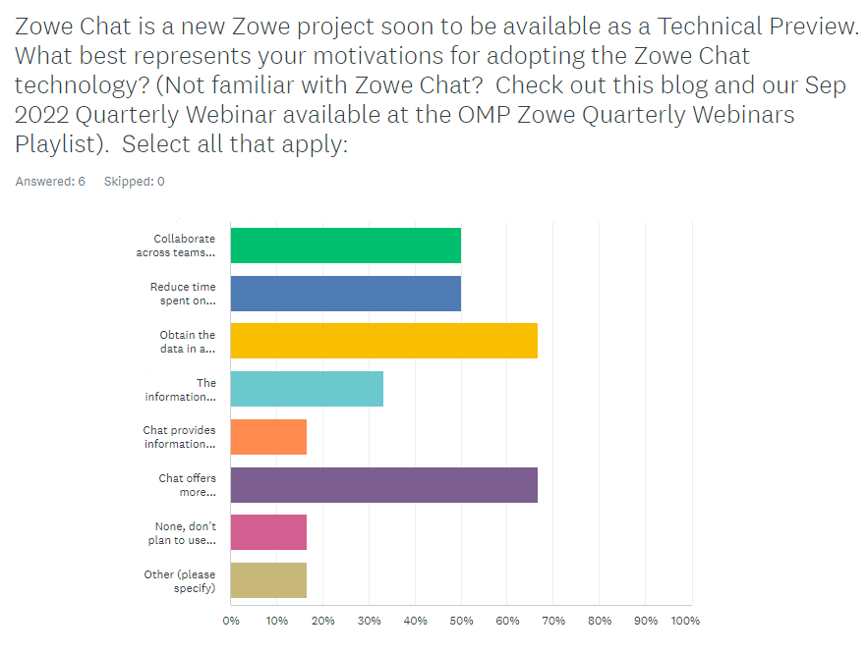
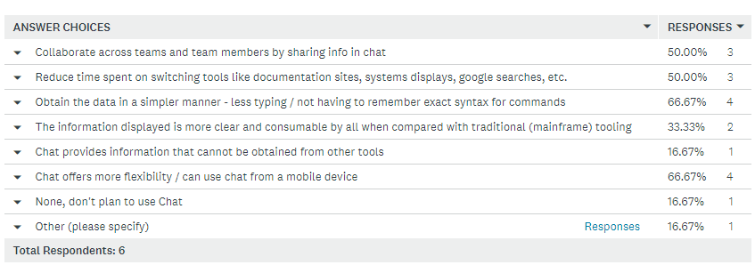
Zowe Open Source Community Feedback
Question-of-the-month: October (to-date)
Zowe Chat Feedback
Notes:
Observations:
Small sample size (6): >50% see 4 motivating use cases for adoption Zowe Chat!
Other (1)
This is a test

Slide 6

Looking Back Three Months
Although the ZAC can’t take credit for progress
Strategic Planning
Lead efforts to complete Zowe Roadmap and collaborate with TSC
Identify & close gaps then bring visibility to Zowe security narrative
Focus on container strategy and messaging
Identify & plan key initiatives to drive V2.0 Adoption
Extender Diversity
Continue work on dramatically attracting Zowe participants
Tech, Tooling, & Hardware
Continue pushing zBox configuration in support of Training & Certification
Notes:
Comments & Concerns:
Provided a template for the squads / Roadmap last planning
Introduced a 1st pass at roadmap, presented at 9/28 quarterly webinar
Zowe Security; continue to discuss new policies and vendor practices and identify potential gaps / delivered blogs – OMP session highlighting Security
Container strategy: No focus this Q
V2 adoption initiatives: Focus on conference sessions and customer interactions
Extender diversity: green ? Increase in contributors & V2 conformant extensions / yellow? No net-new vendors / more work to do around value-add for Extenders
zBOX configuration: the box has a “home” and OMP has committed to FY23 configuration

Slide 7
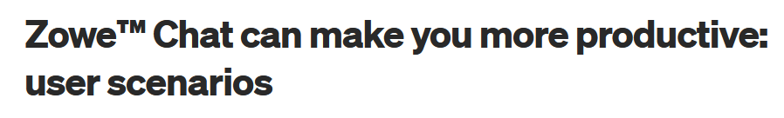
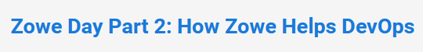
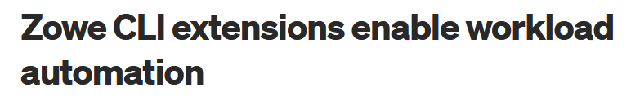
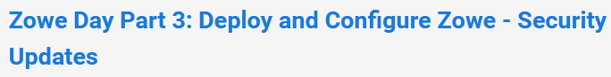
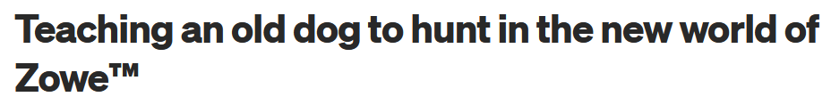
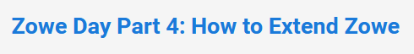
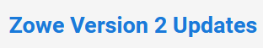
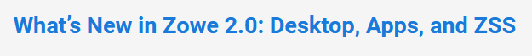
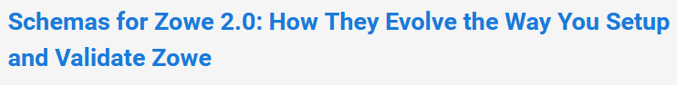
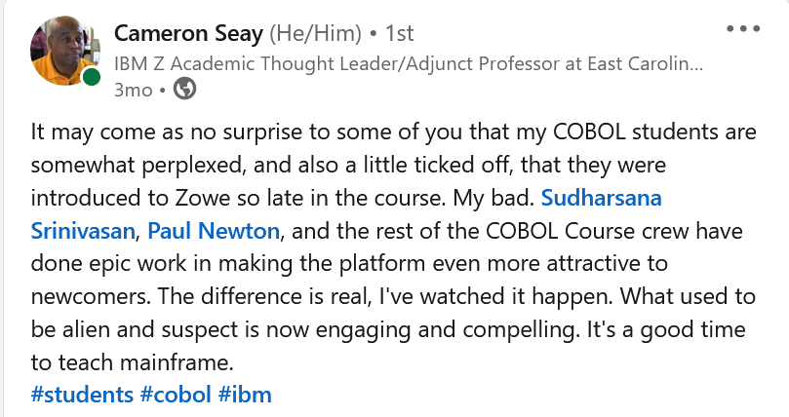
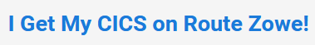
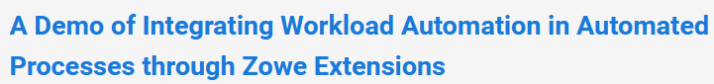
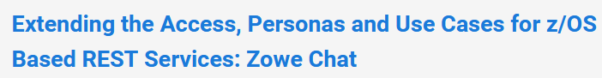
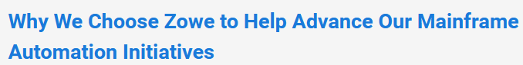
Zowe Social
https://medium.com/zowe
LinkedIn 7500+ views, Medium 281 Views, 143 Reads
SHARE Columbus 2022
Zowe Day
Sessions submitted for doing the same March 2023 in Atlanta
LinkedIn 5300+ views, Medium 229 Views, 166 Reads
LinkedIn 6200+ views, Medium 163 Views, 44 Reads
LinkedIn
Notes:
Successful SHARE showcasing ZOWE!
On-site attendance – virtual attendance
9:45 AM - 10:45 AM - Zowe Day Part 1: Overview of Zowe, Today, and Beyond
11:00 AM - 12:00 PM - Zowe Day Part 2: How Zowe Helps DevOps
1:45 PM - 2:45 PM - Zowe Day Part 3: Deploy and Configure Zowe - Security Updates
3:15 PM - 4:15 PM - Zowe Day Part 4: How to Extend Zowe

Slide 8


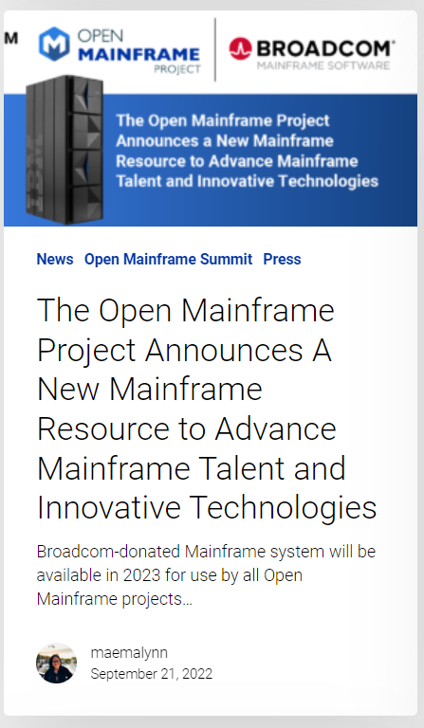
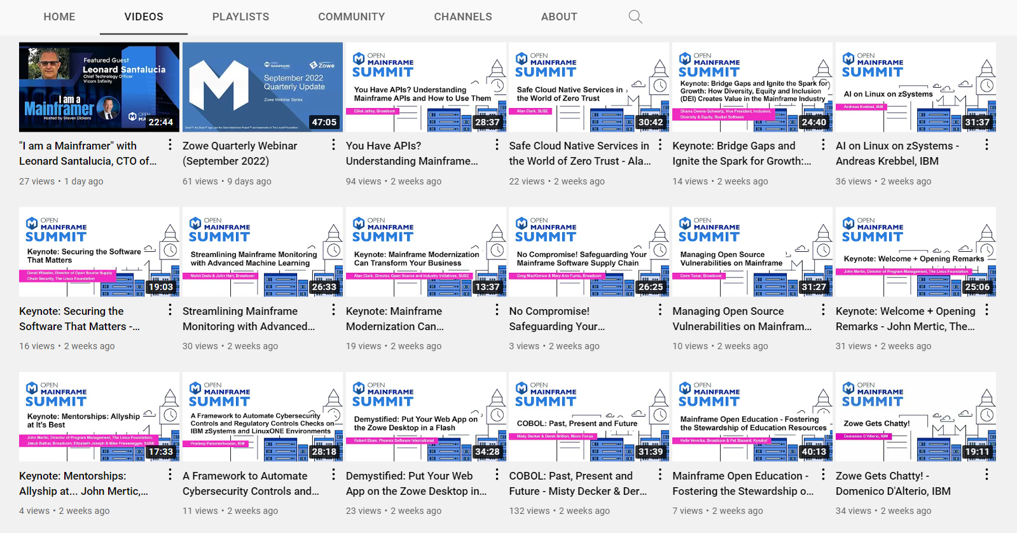
Zowe Sessions at Open Mainframe Summit
https://www.youtube.com/c/OpenMainframeProject/videos

Slide 9
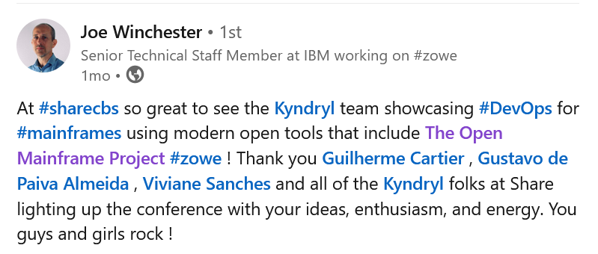
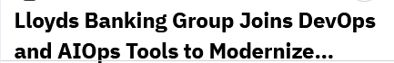
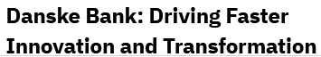
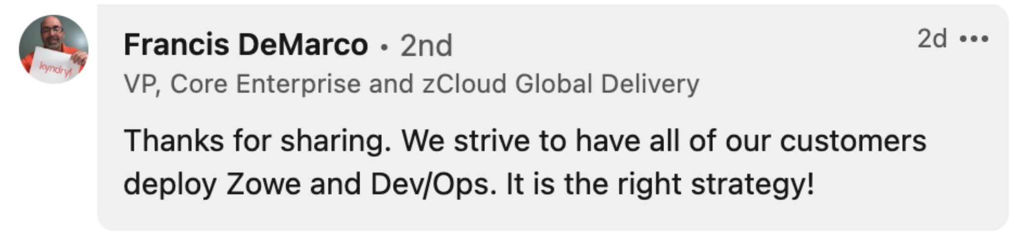
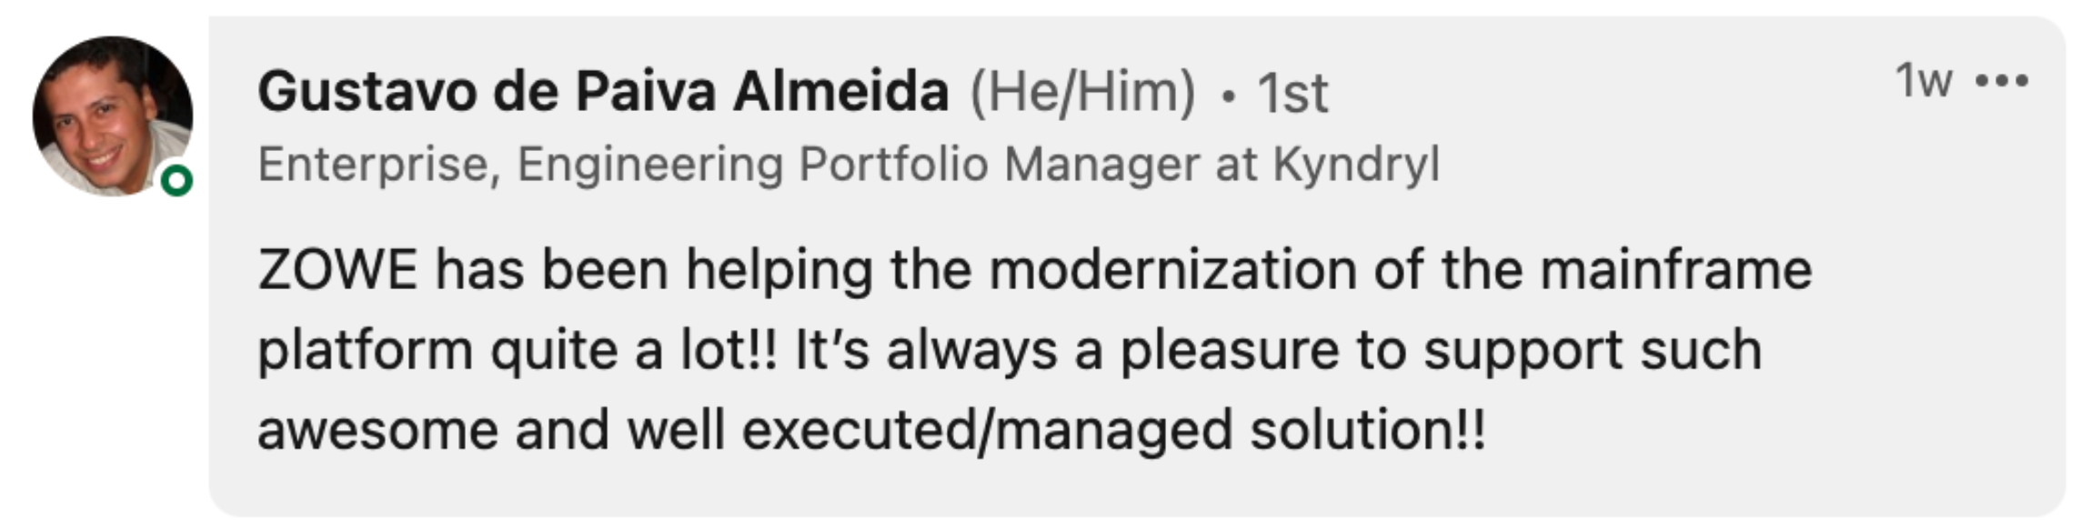
Example Use Cases
Talks about their Zowe CLI and SDK usage and success POCs (See links to IBM Z Day recordings)
Stephen Westbrook Lloyds Banking Group
Suresh Raja Arumugam Nordea
Large European Financial Institution use of Zowe API ML

Slide 10
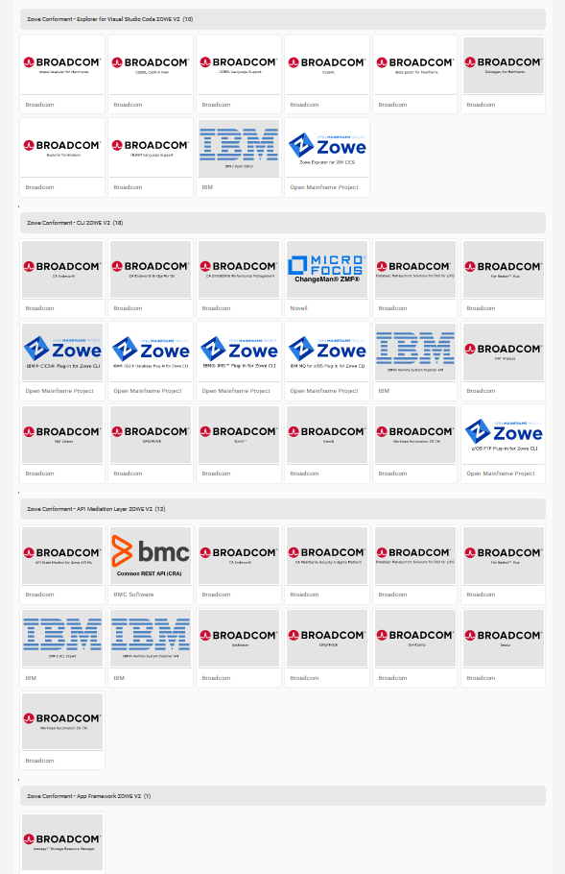
Zowe V2 Conformance
How are we doing?
Explorer (VS Code) - 10
CLI - 18
API ML - 13
App Framework - 1
42 V2 badges
Notes:
API-ML 13/26 (50%)
App Framework 1/8 (12%)
CLI 18/30 (60%)
Explorer 10/13 (77%)
Overall: 55%

Slide 11
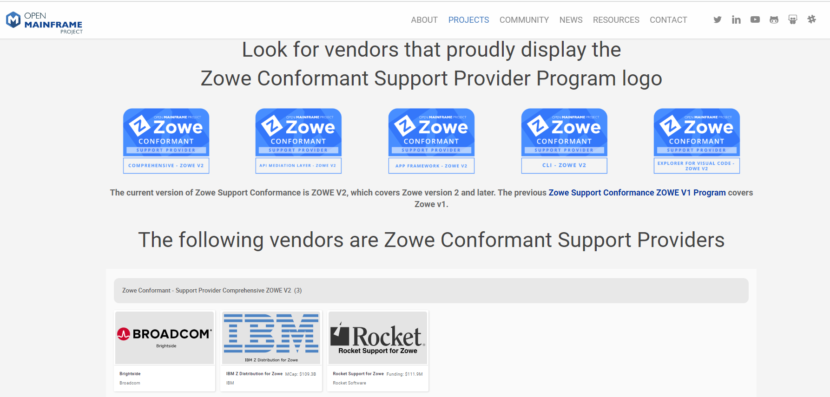
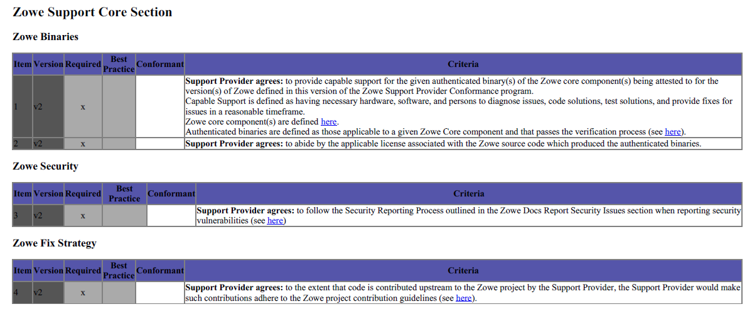
Speaking of Conformance – Support Provider Conformance
https://www.openmainframeproject.org/all-projects/zowe/conformant-support-provider

Slide 12
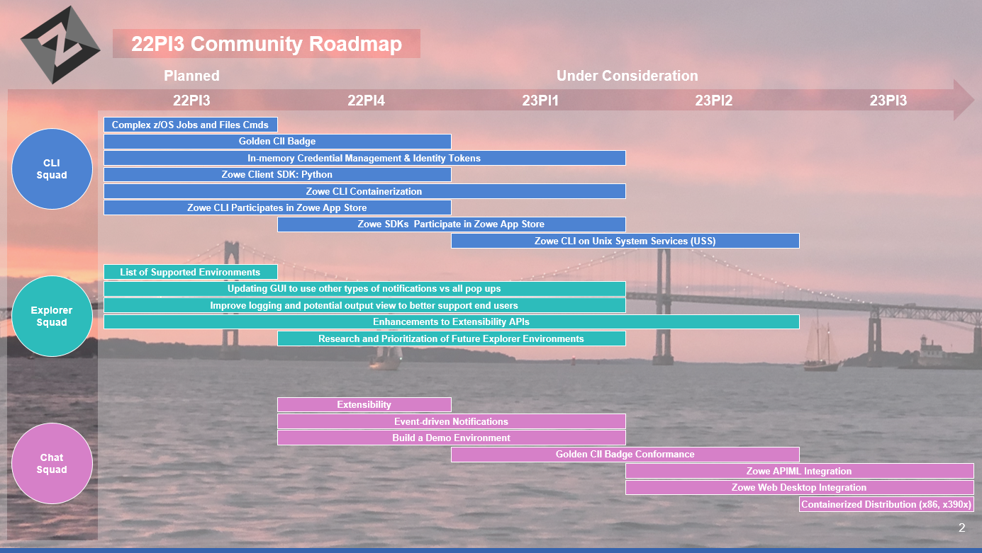
Reminder: Zowe Roadmap
The Challenge – How to Automate the Creation, Merger and Maintenance of the Roadmap for our consumers?
Themes?, Key Word Search?, Thumbs Up?, Wish List?, Suggestion Box?
Content Logistics
- 12 month timeline
- Includes all Zowe projects
- Deliverables by quarter
- Content refreshed quarterly
(an outcome of PI planning)
- Presented as “problems to solve”
We don’t think editing PPT is the best answer?
Notes:
The Zowe roadmap content must:
- map out a full year of intentions for each Zowe project
- include the intentions of all Zowe projects
- identify intended deliverables by quarter to align with the PI Planning cadence
- be kept current, updated quarterly as an outcome of PI Planning
- communicate in terms of problems to be solved, not technology to be developed
- be shared publicly with the community to solicit and incorporate feedback
Each quarter, by the end of PI Planning, each of the Zowe squads will deliver the current list of their roadmap content in the format previously agreed upon and consistent across squads.
For each roadmap item included in the content, the squad will identify:
- the specific Zowe component for which the content applies
- the high-level theme with which the item most closely aligns
- the specific problem being addressed, as concisely as possible
- the calendar quarter in which the work is intended to begin
- the calendar quarter in which the item will be delivered
Note - A template will be provided to facilitate the process of entering this information consistently.
Example
This is an example how API ML one could look like in Zenhub with addition of few other items from the general Zowe:
https://app.zenhub.com/workspaces/community-5c93e02fa70b456d35b8f0ed/roadmap?invite=true

Slide 13
Looking Forward - What’s on ZAC’s mind?
22PI4
Strategic Planning
Close to complete Zowe Roadmap and collaborate with TSC
Identify & close gaps then bring visibility to Zowe security narrative
Explore consumer demand for “z/OS Event Infrastructure” (expansion of Zowe Chat event architecture)
Research with TSC the demand on internationalization of Zowe components
Extender Diversity
Leverage Zowe Chat to expand Zowe participants
Tech, Tooling, & Hardware
Continue exploration with OMP/TSC in support of Training & Certification

Slide 14
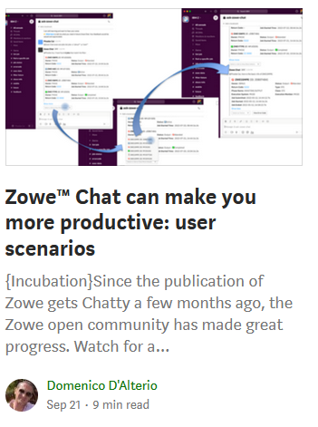


Zowe Chat V1 features
Technical preview available by end of October
Current plan for V1 availability: March 2023
Resource management:
z/OS Job
Query jobs with drilldown capabilities
View details of a specific job
Dataset
Query datasets with drilldown capabilities
Query members of a specific Dataset
USS file
Issue an MVS command
Zowe CLI command
Query knowledgebase error code for z/OS message
Send alert/event to channels
Extensibility
Plug-in mechanism
Security – Basic Auth Workflow
Chat tools being supported:
(*) items in italic are stretch goals
https://medium.com/zowe/zowe-chat-can-make-you-more-productive-user-scenarios-f52a9985dd50
MatterMost
Slack

Slide 15

The Challenge
There is likely to be continuous scrutiny (and eventually laws) of open source security
"Vulnerabilities and weaknesses in widely deployed software present systemic threats to the security and stability of modern society as government services, infrastructure providers, nonprofits and the vast majority of private businesses rely on software in order to function."
Open Source Software Security Mobilization Plan from the OpenSSF and Linux Foundation
https://www.washingtonpost.com/politics/2022/09/22/senators-introduce-bill-protect-open-source-software/

Slide 16
Q&A
Notes:
Questions?

